Slide 1
Presentation 1
Camilo Aguilar

Slide 2
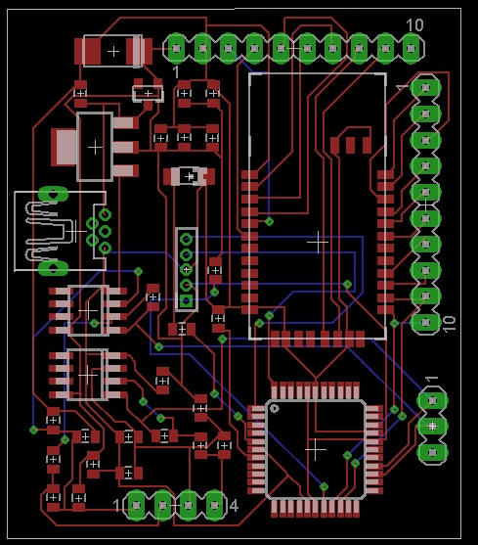
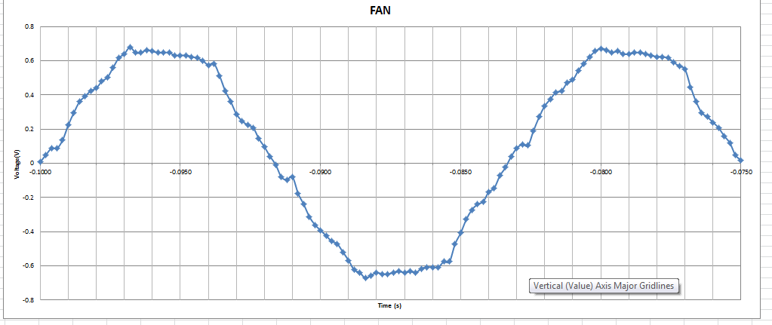
Short Term Goals:
Understand Load Signatures.
Signal decomposing and processing.
Understanding hardware implementation and troubleshooting
Hardware
Load Signatures
Source: Surf PPT Presentation

Slide 3
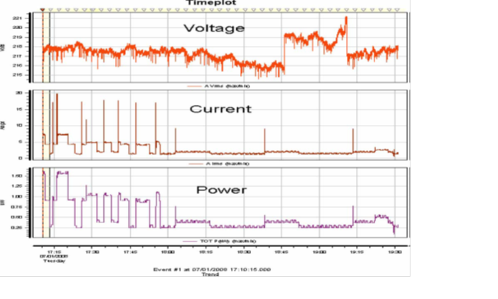
Load Signature
Electrical behavior
Understand and analyze:
Control devices
Energy Management

Slide 4
Variables Load Signatures
Voltage (V)
Current (i)
Power (P)

Slide 5
1 appliance vs n appliances

Slide 6
Principle Superposition = Composite Load

Slide 7
Composite Load
Unique features from appliances are mixed
Certain features may be masked or lost. Decompose signals:
Snapshot Form: Instantaneous snapshot of the load behavior taken at a fixed time intervals.
Delta Form: Difference between two consecutive snapshots form signatures.

Slide 8
Criteria to Classify Composite waveforms
Current waveform
Active and reactive power
Harmonics
Instantaneous Admittance Waveform
Instantaneous Power Waveform
Eigen Values

Slide 9
Propositions
Set a fix interval
Normalize the data
Set a threshold variation. (difference in voltage, power, current)
Detect events by switching on/off appliances.
By analyzing delta forms, and using an algorithm, extract feature changed.
With a known database of features, match database with change in composite load signature.

Slide 10
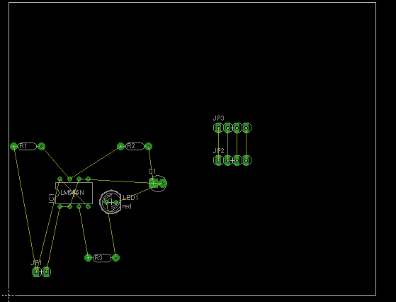
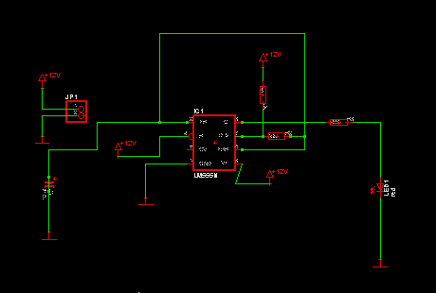
Eagle

Slide 11
Long Term Goals
Implementing knowledge about load signature decomposition with hardware
Developing the program that will recognize each appliance

